Slide 1
Introduction to Programming Using Python

Slide 2
Instructor – Ray Smith raysmith@alum.mit.edu
Many years of Programming – engineering, scientific, financial
Commercial, Scientific, Systems Languages – C, C++, Perl, Java, Python, Assembly
NEW Areas - Games for young 3-8 years
Notes:
What would you like to know about me?

Slide 3
Objectives
Programming for non-programmers
Demonstrate Operations and Methods
Enable and energize new programmers
Learning by DOING
Notes:
What do you want from this course?
What do you want from programming?

Slide 4
Our Online Class – Using Zoom
If any background noise, please mute – minimizes cumulative noise
Disable own video – too many affects view
Can question via Chat – can be to ALL
Expecting Response: Start "QUESTION:"
Notes:
What do you want from this course?
What do you want from programming?

Slide 5
Introduction To Python – Session Progression
Lecture 1.5 Hours
Follow-up Questions .5 Hours
Similar to Programming – This Course
Skips, Repeats / Revisits
Student Guideline:
If you know it – Have Patience
If confused / unsure – ASK QUESTIONS

Slide 6
Programming Telling the Computer What to Do
The language, PYTHON, is the way
Popular, Powerful, and EASY
Like most human languages - Don’t have to know all
Notes:
What should the computer do for you?
What should the programming language (Python) do?

Slide 7
Learn by DOING
Using Python's built in tool IDLE
Integrated Development and Learning Environment
Interactive execution of Python parts
Python Program editor and execution
Lots of documentation, examples, help
Notes:
Who hasn't downloaded python (from www.python.org)?

Slide 8
Blazing Introduction to Parts of Python
Run Python IDLE
Follow along with instructor
– copy, experiment, question
>>> 1 + 1
2
Notes:
Make shortcut?

Slide 9
Blazing Introduction – continued
>>>: IDLE shell prompt (to you the user)
# : start of comment to be ignored
Otherwise: printout from IDLE
>>> 1 + 1 # Comment on 1 + 1
Notes:
Offline self-guide file: exercises/python_introduction.py

Slide 10
Blazing Introduction – Changed my mind.
Edit a line by "up arrow" to line and pressing ENTER, then make change
ALT-P(Cth-P on MAC) will "open" last command for change
After editing, press ENTER to execute changed command

Slide 11
Blazing Introduction – Did we mention...
1+1, *, /, -, %, **, //, 1+2;3+4,
"a", 'b', """c""", ''''d''',
"Ray" + " " + "Smith"
print(1, "one", 2, "two")
var_name = 1
===============================================
if, else, elif, True, False
a == b, a != b, a > b, a < b, a >= b
while, for, break, continue

Slide 12
Creating Python files (using IDLE)
Create file File ➔ New File
… add text
File ➔ Save
Maybe in folder “classwork” ???
Reuse - File ➔ Save As ➔ …new name
Notes:
What is a file?
editing
location
What are the issues with a file?

Slide 13
Hello World!
Create file
File ➔ New File + File ➔ Save As…
File ➔ Recent Files + File ➔ Save As…

Slide 14
Hello World! - You Try!
Write simple program:
print("Hello World!")
print("My name is student.")
Save file – File ➔ Save
Run program – Run ➔ Run Module
Notes:
How about goodbye_world.py ?

Slide 15
In this Course - You will see a bit of Programming …
What is programming
Like
Not like
Programming Tools
Creating, Running
Improving through – copy, iteration

Slide 16
You will see a bit of Python …
What is Python – A Programming Language
Comments
Values – Integer, Float, String
Variables – contain values
Computation / Arithmetic
Rules / Style

Slide 17
You will see a bit more Python …
Decisions – if, else
Looping – while, for, break, continue
Grouping – indentation, functions, classes
Functions – parameters, returning
Data Structures – lists, dictionaries

Slide 18
Computer == VERY Obedient Servant
Car Example
Most cars are alike
Does what you tell it – hopefully what you want
Same response every time – almost – e.g. forward / backward
Troubles - Car gets the blame…
Notes:
What does a car do for you?
What does a car do that you don't really need / want?
What is the most difficult thing about using a new car?

Slide 19
Similar activities
Abstract / Indirect
Cooking recipes
Travel directions
Assembly instructions
Physical – What you see is what you get
Construction - Roads, Buildings
Notes:
What's difficult about using recipes, maps, instructions?

Slide 20
Like Computer Programming
Build once – use many times
Builder and user(s) often different
Building errors show up many times
Mistakes don't always show up immediately

Slide 21
Not so like Computer Programming
Physical materials
Hard to copy
Hard to manipulate
Easy to see

Slide 22
What's Easy – No so physical
Creation / copying / moving is a snap
Don't wear out
Change easy
Work on new, while using old
Notes:
What makes programming easy/easier than work in the "physical" workplace?

Slide 23
What's Not Easy – because No so physical
Can't "see" it
Everything connected – unexpected consequences
Not easy to tell how close to done
Notes:
What is not so easy in programming?

Slide 24
Our Sandbox – IDLE Demonstration and Testing
https://www.python.org
Download latest python example: 3.7.0
Python shell
Documentation
IDE - editor, execution, debugger
Notes:
What would you like from a programming tool / helper?
IDLE can provide the environment for us to directly use Python to do things.
What's necessary?

Slide 25
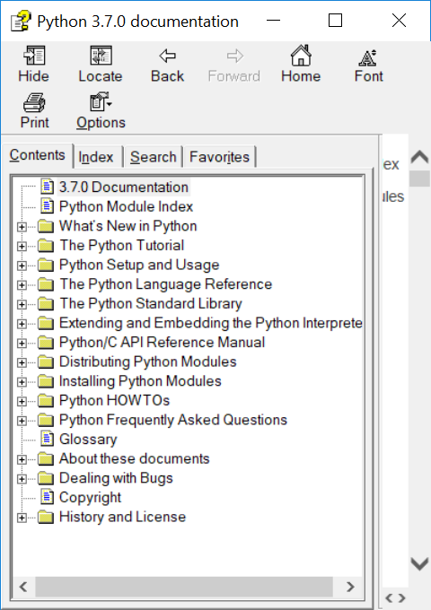
Documentation – Lots of Nice STUFF

Slide 26
IDLE – continued
Python Documentation:
Help ➔ Python Docs
Help on IDLE:
Help ➔ IDLE Help
Python Program Examples:
Help ➔ Turtle Demo
Notes:
What should IDLE do for you?

Slide 27
IDLE - A Quick Introduction to Python with a offline guide file
A file with some beginning examples
open python_introduction.py
File → Open →… exercises → python_introduction.py

Slide 28
Python_introduction.py…beginning a wordy text file guide
Python 3.7.4 (tags/v3.7.4:e09359112e, Jul 8 2019, 20:34:20) [MSC v.1916 64 bit (AMD64)] on win32
Type "help", "copyright", "credits" or "license()" for more information.
>>> # The following is an interactive introduction to basic Python concepts.
>>> # The text is pretty much as I typed it in to the Python IDLE shell,
>>> # and got printed out by the shell python shell evaluation.
Notes:
First few lines are just information about this version of IDLE.
Plus, you can always type "help".

Slide 29
Python_introduction.py…continued
>>> # You might get some useful practice by trying these examples on your
>>> # computer in the IDLE shell.
>>> # Lines with # are ignored by python from the # character to line end.
>>> # This introduction takes place within the python IDLE interpreter
Notes:
Repetition because some folks just use this file.
File was created while running IDLE and learning!

Slide 30
Python_introduction.py…continued
>>> # Lines starting with ">>> " can be directly typed, minus the ">>> ",
>>> # into IDLE
>>> # Text typed after the ">>> " is evaluated by python, and the value,
>>> # if any, is displayed.
>>> 1
1
>>> 1 + 2
3
Notes:
You may want to refer to this later for review.

Slide 31
A Quick Introduction to Python – continued If using Python_introduction.py as guide
Repeat each example from file
Try a couple of your own making
Don't worry about mistakes!
Ask questions.

Slide 32
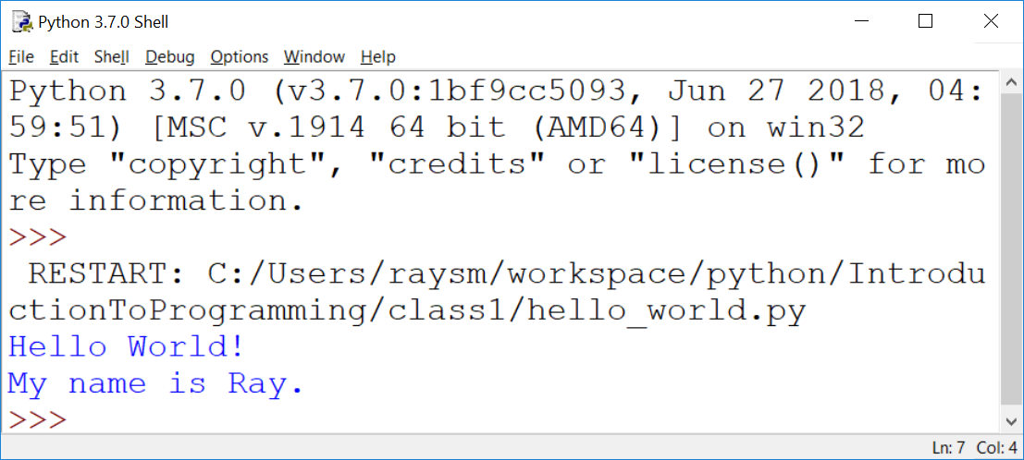
Hello World! - output

Slide 33
Python Language - Minimum
# Comment – Just say it
# "#" to the end of line
# Not executed but what is wanted
""" Doc Strings – Multiple lines
Good to start and end
on empty lines
"""
Notes:
What does the programming language do?
What should the programming language have?

Slide 34
Second Session Begins
Programming Calisthenics
5 minutes - Using IDLE
Do One Example of EVERYTING you have seen
Don't worry about mistakes, errors – that's what IDLE is there for, errors are SOMETHING too
Done Early – Do Two Examples
E.g. 1+2, a=5, a**3, if a == 5

Slide 35
A Quick Review of Python
What is
>>>
# stuff here
1
1 + 2

Slide 36
A Quick Review of Python
What is
A string
"here we are"
'there we go'
"It's the way"

Slide 37
A Quick Review of Python - continue
What is
"""
More and
More
"""

Slide 38
A Quick Review of Python - continue
What is
4;5;6
2+3,2*3

Slide 39
A Quick Review of Python - continue
How do we print a value?
On an IDLE line?
Using "print"

Slide 40
A Quick Review of Python - continue
How do we print:
"Hello World!"?
The sum of 1 plus 2?
Three strings "a", "bc", "def"?

Slide 41
A Quick Review of Python - continue
What is a variable?
Of what good is a variable?
Rules for naming a variable?
How do we:
Set up a variable?
Use a variable?

Slide 42
A Quick Review of Python - continue
What does this do:
first = "who"
print(first, "is on first")

Slide 43
A Quick Review of Python - continue
Legal variable names? Why?
a
tom
max_val
A21
target_hi __file__

Slide 44
A Quick Review Python - continue
Illegal variable names? Why?
1a
my name
short-stop
high.val

Slide 45
A Quick Review of Python - continue
What are some program flows?
What are some decisions to be made in program flow?
What are some Python decision making keywords?
How is each decision keyword used?

Slide 46
A Quick Review of Python - continue
Write a test that prints "a" if a is greater than b. Do we need something first?
Write a test that prints "a" if a is greater than b and "b" if not. Do we need something first?
Notes:
Variables need initialization before they may be used.

Slide 47
A Quick Review of Python - continue
Write a loop that prints the numbers from 1 to 10.
Write a loop that prints the odd numbers from 1 to 9.
Notes:
Variables need initialization before they may be used.

Slide 48
Python Language - continued
Arithmetic almost like algebra class : +,-,*, >, >=, ==
BUT single “=” is for assignment
max_value = 20
value = value + 5
in = pr * (1+rate)**years

Slide 49
Python Language – print function
Prints one or more values
Separate values by commas (,)
print("Hello")
print("value: ", 10)
print("Maximum: ", max)

Slide 50
Python Language – print function - more
Inserting variables/values
v_str = "string value"
v_int = 123
print(f"this has v_str={v_str}") print(f"this has v_int={v_int}")

Slide 51
Python Language – formatted string in action
>>> v_str = "string value"
>>> v_int = 123
>>> print(f"this has v_str={v_str}")
this has v_str=string value
>>> print(f"this has v_int={v_int}")
this has v_int=123
>>>

Slide 52
Python Language - Testing
“if” condition “:”
One or more indented lines
if value > max_value:
print("value", value, " is big")
print("Try less than", max_value)

Slide 53
Python Language - Looping
“while” condition “:”
One or more statements indented
to the SAME indentation
while value < max_value:
print("value ", value, " is OK")
value = value + 10
print("value is now", value)
Notes:
Why loops?
What should a loop have / do?

Slide 54
Exercise: “Times Tables” for 13 – 1x13, 2x13, …,13x13
Hints:
Create new file named “timestable.py”
Setup: name and set variables – nval = 13 first =1 last = nval n = first
Loop: while n <= last:
print(n, "x", nval, "=", n * nval)

Slide 55
Python Language – input function
Get user input
inp = input()
Prompt user first
inp = input("Please enter:")
Convert to Integer
nval = int(inp)
Notes:
Accepting input and dealing with it makes programs much more powerful than calculators or Television.

Slide 56
Exercise: “Times Tables” – with user giving number
Hints:
Use “timestable.py” as start
New file name = “timestableN.py”
Replace “13” with variable “nval”
Use inp = input("Enter mult:")
Use nval = int(inp)
Notes:
Why a NEW file name?
When do we create it?
WHY?

Slide 57
Exercise for LATER: “Times Tables” – Full table from 1x1 to NxN
Hints:
timestableN.py → timestableNbyN.py
How to do it by hand?
How many loops?
What are the variables?
Notes:
What are the issues?
What's the most difficult thing to achieve.

Slide 58
A Real Life Program We Can do
I’m thinking of a number …
Simplification - Helps the user
Get guess - tell if greater, less, equal
Iteration - learn along the way
Notes:
What sort of programs are there? Could there be?
Calculators – financial, industrial
Games

Slide 59
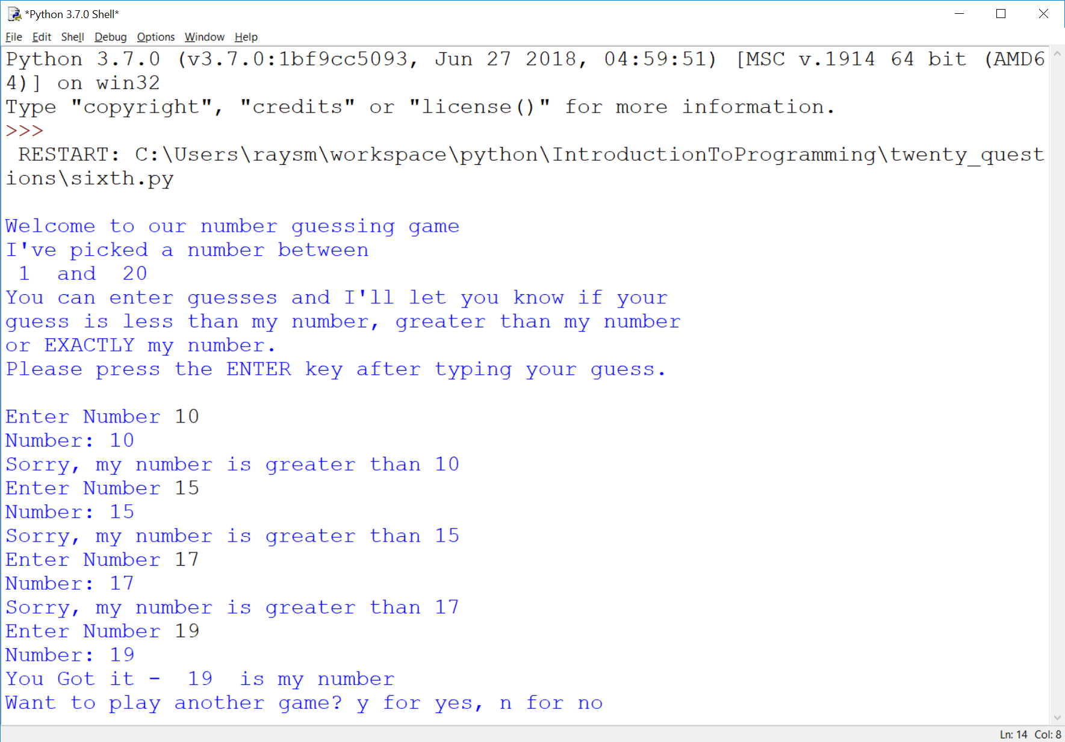
Here’s the goal
Notes:
What should we be able to do with programs?

Slide 60
Guessing Game – Iteration 1
Create new file named “first.py”
Do the smallest part
Loop, asking number
Print number entered
Notes:
What is iteration?
Why iteration?
Any problems with iteration?
What's in a game?
goals
interaction
input
output
beginning, middle, end

Slide 61
Guessing Game – Iteration 1 - continued
Hints:
Place comments describing task
Use while True:
What variables?
Use string = input("…")

Slide 62
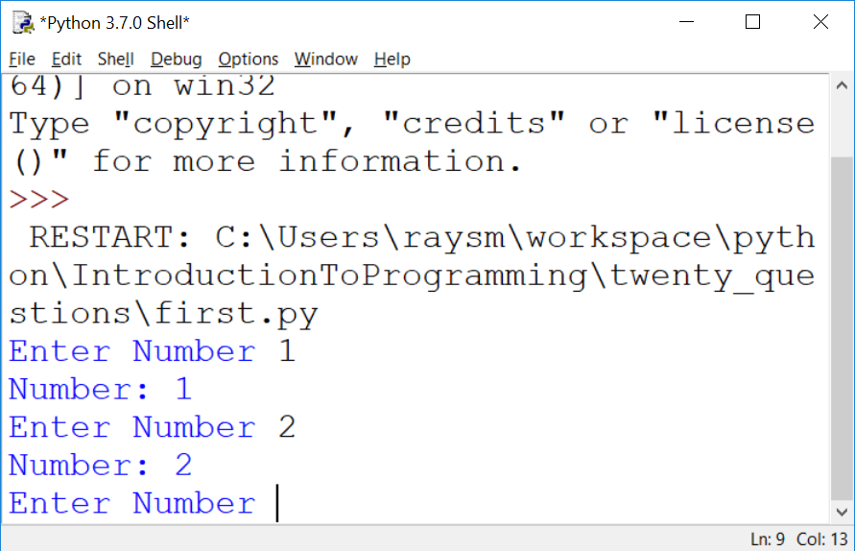
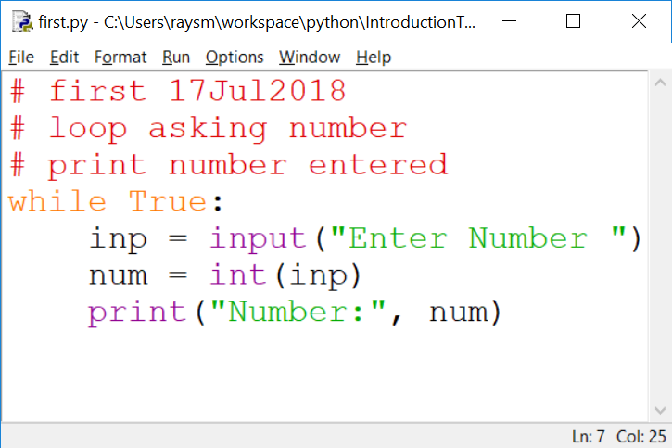
The First Iteration
Notes:
What do we get from doing this iteration?
learning
testing
early fun?
What does it cost us?

Slide 63
Second Iteration – A bit More
Set target value
Quit if number entered number equals target
Hints:
Start from first.py
Use break to quit while loop
Notes:
Why use File→Save As ("second.py") BEFORE any changes or additions?
HINT: What happens if, after one does a lot of additions, one does File→Save ?
What happens to the original "first.py" file contents?

Slide 64
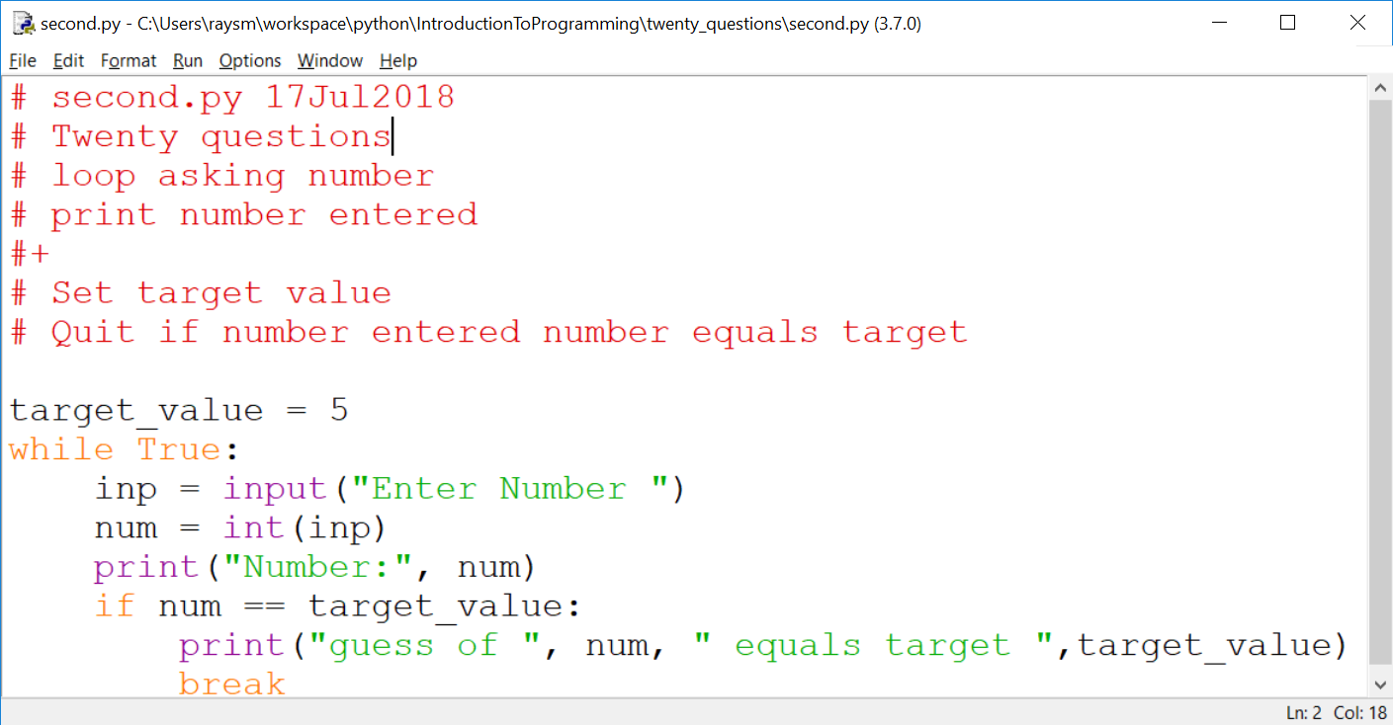
Second Iteration – continued

Slide 65
Thinking of Iterations
Think Features
Prioritize
Order most to least / easy to hard
Build to the next
Balance Big Bang! with Show it Now!
Show progress
Notes:
What is(are) the simplest idea(s)
Before anything else what does the program do?
What's the next?

Slide 66
Sample Iterations
First:
loop asking number
print number entered
Second:
Set target value
Quit if number entered number equals target

Slide 67
Think of the Iterations - continued
Third: Say if greater, less or equal
Fourth: Say goals, rules before start, including "a number between…"
Fifth: Ask user if they want another game – play multiple times
Sixth: Set target to random number
Seventh: Handle typos / illegal numbers

Slide 68
More Python – Variables Places to store values
Holds data, with a name
Eases the use/reuse our data/results
Names have rules:
Start with a letter (a-zA-Z_)
Followed by zero or more digits (0-9) or letters
OK - a, a1, my_variable, a2or3
NOT - 1, 1a, my-variable, "ray,smith"
Notes:
Why variables?
What are the issues with variables?

Slide 69
Python Language Guidelines with some exceptions
A statement is on ONE line
YES:
sum = 1 + 2
NO:
sum = 1 +
2
Parenthesized grouping may be on multiple lines
YES: sum = (1
+ 2)
Notes:
Note any place that has parentheses allows multi-line / indentation free formatting. Examples: arithmetic (….), print(….), and other functions.

Slide 70
Python Language Guidelines - continued
A group of statements:
Are executed in order
Must start at same indentation (from left)
BUT Parenthesized grouping may have any indentation within the parentheses
Notes:
Don't mix spaces and tabs
Stick with spaces
Editor can help

Slide 71
Python Language Guidelines - continued
YES:
start = 1
last = 3
increment = 1
NO:
start = 1
last = 3
increment = 1

Slide 72
Python import Bring in support
Importing brings in support
import random # for random numbers
from random import randint # just named
Examples will often include import statements
Notes:
Where do we find examples?
Internet
Documentation
Tutorials

Slide 73
Help is a click away Web searching
Try "python thingies …"
E.g. python random int between two numbers
Found: python - Generate random integers between 0 and 9 - Stack Overflow
GOT:
Try:
from random import randint
print(randint(0, 9))

Slide 74
Help is a click away Web searching - continued
Be brief – search algorithms are pretty good
First code may be wrong.
Someone saying Did this … didn't work
Stackoverflow.com
Question…
Answer…
Checkmark – Best liked answer
Answer…
Notes:
Internet is like a bunch of varied friends
Often correct but sometimes on a different track

Slide 75
Exercises - Iterations - continued
Do Iterations third, fourth
Third: Say if guess greater, less or equal
Fourth: Say goals, rules before start
Simple iterations are practice
Notes:
Use the previous iteration as a start to the next.
I'll go around and watch.
Raise had if a question.

Slide 76
Functions – Divide and Conquer
Hide the particulars
Delay consideration
Parts of the problem placed in functions

Slide 77
Functions – continued
Called (invoked/started) with name(comma-separated list of parameter values)
Returns result of operation
top = max(1,2,3)

Slide 78
Functions – continued
Function Definition – what it is going to do
Name – same style/restrictions as variable name
Parameters – data which is passed to the function
Comma-separated list

Slide 79
Functions – continued
Body – Where the actions are
Regular code
Uses data passed in parameters by parameter names

Slide 80
Functions – continued
def add2(value1, value2):
sum = value1 + value2
return sum
sum1 = add2(1,2) # sum1 gets 1+2
sum2 = add2(3,4) # sum2 gets 3+4
Notes:
Function Calling / Invocation
How do we call the function?
Called with the function name
Including parenthesized list of values
The values are passed to the function

Slide 81
Functions – continued Exercise – Special Product Function
Write a function product(factor1, factor2, factor3)
Returns the product of the values factor1, factor2, factor3.
Test it on the following:
.5, .4, .3; 1, 2, 3; -1, -1, -1;
Notes:
Function Calling / Invocation
How do we call the function?
Called with the function name
Including parenthesized list of values
The values are passed to the function

Slide 82
Functions – Keyword parameters
Optional – for seldom used
Any Order – avoids ordering confusion
Parameter names help understanding
myfun(key1=2, key2=7)
myfun(key1=4) # default - key2
myfun() # All defaulting
Notes:
Missing or misplaced function arguments are a big problem

Slide 83
Functions – Keyword parameters - continued
def myfun(key1=None, key2=7):
if key1 is None:
key1 = 5 # key1 not present
return key1 + key2
Notes:
What are the benefits of using None vs explicit value?
None is used to definitely indicate no value was supplied.
In this case – the call was made without the keyword parameter.

Slide 84
Functions – Keyword parameters – example – built-in function: print()
def print(*args, end="\n", sep=" ")
print("a", "b", sep=":") #different sep
Print("c","d", end="") #No end line
Exercise: Try using each print keyword

Slide 85
Functions – Keyword parameters – print() Exercise 2: – Print factors – factors.py
Prompt user for n
For numbers 1 to n, print factors
1: 1
2: 1,2 - factors on same line
3: 1, 3
4: 1,2,4
5: 1,5
6: 1,2,3,6

Slide 86
Functions – Keyword parameters – print Exercise
Improvements:
Omit 1, and number itself as factors
Only print numbers with at least one factor other than 1 or itself
Extra: Use "for" loop

Slide 87
Lists / Arrays – numbered / expandable
Named group of values
friends = ["tom", "dick", "jane"]
Access by position
print("1st, 3d:", friends[0], friends[2])
Add to end
friends.append("joe")
Notes:
First element at index: 0
Last element at index: len()-1
What sort of information would fit into a list?

Slide 88
Functions – an Example – Friends and Family
Assume a database or game or organization which includes friends
Needs utilities / worker functions
Add friends, list friends, check if one is a friend, …
Build up – friends_family/ friends_1.py, …
Notes:
First element at index: 0
Last element at index: len()-1
What sort of information would fit into a list?

Slide 89
Strings - Like a lists of characters - ALMOST
Assigned as a group, not via index
str_name = "abcdef"
NOT str_name[0] = "a"
Can be Accessed by index
if str_name[1] == "b":
print("Yep it’s the second character")
Notes:
What sort of information would fit into a string?

Slide 90
Strings - continued
Strings can't be changed in place (immutable)
But += works
name += last_name
Because x += y defined as x = x + y
name = name + last_name
Notes:
Not modifiable == immutable
Don't change – replace - a = (do stuff with a or parts of a)

Slide 91
Strings – continued - immutable
Not modifiable == immutable
Don't change – replace
str_name = "a" + str_name[1:]
Notes:
Not modifiable == immutable
Don't change – replace - a = (do stuff with a or parts of a)

Slide 92
Dictionary - Group of values - Access by name
trades_d = {
"painter" : "tom",
"landscaper" : "joe",
"plumber" : "kate"
}
print("landscaper:", trades_d["landscaper"])
Notes:
What sort of information would fit into a dictionary?

Slide 93
Dictionary - continued
for trade in trades_d:
print(trade, trades_d[trade])
for tra, who in trades_d.items():
print(tra, who)
trades_d["programmer"] = "ray"
Notes:
.

Slide 94
F-string – easer print formatting
building print strings
Put "f" before first quote
Place variable inside "{}"
t_nm = "Tom"
m_nm = "Mary"
print(f"tom={t_nm} mary={m_nm}")
Notes:
.

Slide 95
F-string – continued
{variable/expression:formatting}
:5d – integer 5 places
:5.2 – float 5 places, 2 dec pt
:>5 – string 5 places right justified
Notes:
.

Slide 96
F-string – continued
runners = { "tom" : { "count" : 5,
"time" : 3.8
},
"joe" : { "count" : 7,
"time" : 5.728
},
"mary" : { "count" : 10,
"time" : 7.62
}
}
Notes:
.

Slide 97
F-string – continued
# Print Heading
print(f"{'name':10}"
+ f" {'count':5}{'time':>5}")
for rname in runners:
info = runners[rname]
print(f"{rname:10} {info['count']:5d}"
+ f" {info['time']:5.3f}")
Notes:
.

Slide 98
F-string – continued
Output:
name count time
tom 5 3.800
joe 7 5.728
mary 10 7.620
Notes:
.

Slide 99
Files Data that remains
Stream of bytes/characters "on disk"
Has a File Name
Open File – Create, if new
Read / Write sequentially
Close File
Notes:
File, as a named group of bytes is an abstraction.
Years ago the programmer needed to understand more about the structure.
Your Python program is a data file to some program(s).

Slide 100
Files - continued
Stream of bytes/characters "on disk"
Has a File Name
Open File – Create, if new
Read / Write sequentially
Close File
Notes:
File, as a named group of bytes is an abstraction.
Years ago the programmer needed to understand more about the structure.
Your Python program is a data file to some program(s).

Slide 101
Files – continued – Creating
Be careful with names- don't overwrite
#create_file.py
with open("my.txt", "a") as fout:
for i in range(1,5):
print("line %d" % i, file=fout)
Notes:
Open modes "r" –read, "w" – write, "a" - append

Slide 102
Files - continued
# read_file.py
file_name = "my.txt"
with open(file_name) as finp:
for line in finp:
print(line, end="")
Notes:
Note: print adds a newline at the end by default.
To avoid this, use the end="" parameter to replace the default newline with "".
e.g.

Slide 103
Files – continued – Exercises
Create your own two examples
1. create_file.py - Write and check
Save as read_file.py
2. read_file.py – Modify to do reading…
Notes:
What are the benefits of save / modify approach?
What are the pitfalls?

Slide 104
Files – continued Notes - A Simple Data Base
Goal:
Access to my data by name
Plan:
Save data in a text file
Search all lines for patterns e.g. name
Print lines where found

Slide 105
Notes - A Simple Data Base – Continued Details
Create two test files
test.notes – real short just a couple of lines
Joe Name Joe Smith
Joe Address 100 Main
Sam Name Sam Jones
Sam Address 20 Center
Watertown.notes – longer with more varied data

Slide 106
Notes - A Simple Data Base – Continued Details
Make "notes.py" program file.
Will display lines from a text file
that contain a given text string.

Slide 107
Notes - A Simple Data Base – Continued Iterations
1. Read specific file e.g. "test.notes"
print out all lines
2. Print only lines containing "student"
How to match lines ?
2.a Match (Student, STUDENT)
3. Prompt for, then accept file name, pattern
4. [Extra Credit] Multiple text patterns

Slide 108
Future – Python as "Glue"
Python can run other programs
E.g. notepad.exe
import subprocess as sp
fname = "notes.py"
sp.Popen(["notepad.exe", fname])

Slide 109
Finding python.exe from IDLE
Python 3.7.0 (v3.7.0:1bf9cc5093, Jun 27 2018, 04:59:51) [MSC v.1914 64 bit (AMD64)] on win32
Type "copyright", "credits" or "license()" for more information.
>>> import sys
>>> print(sys.executable)
C:\Users\raysm\AppData\Local\Programs\Python\Python37\pythonw.exe
>>>

